Slide 1
July 26, 2022
Web Page Phishing Detection
A model to protect us from cybercriminals
PRESENTERS:
Aniket Patil, Praneet Kumar Alamuri, Anushka Iyer, Jiaxi Wang, Aakash Talathi, Biyun Yuan
The University of Texas at Austin

Slide 2






Meet Our Team
Aniket Patil
Praneet Kumar Alamuri
Anushka Iyer
Jiaxi Wang
Aakash Talathi
Biyun Yuan

Slide 3
We’ll Talk About…
1
What is Phishing? How can we help?
2
The datasets leveraged to identify and resolve the problem
3
ML Models used to identify Phishing Websites
4
Choose the best model and our recommendation to help mitigate Phishing

Slide 4


What is Phishing
Phishing is a cybercrime
A phishing website is a domain similar in name and appearance to an official website
A link as a legitimate institution to lure individuals into providing sensitive data
Result in identity theft and financial loss
Not-So-Fun facts:
Phishing is involved in 90% breaches
The average cost of a breach is $3.86M dollars

Slide 5
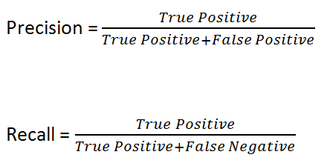
Objective
We want to identify features that will help identify Phishing webpages
We do not want to miss any suspicious phishing website. Therefore, we want False-Negatives to be as low as possible, thus we are prioritizing Recall
Eg: A precision of 0.8 means that 80% of all phishing predictions are actually phishing websites
Eg: A recall of 0.9 means that 90% of actual phishing websites are correctly identified as phishing
Notes:
After fitting three models
RFE on Random forest best features

Slide 6
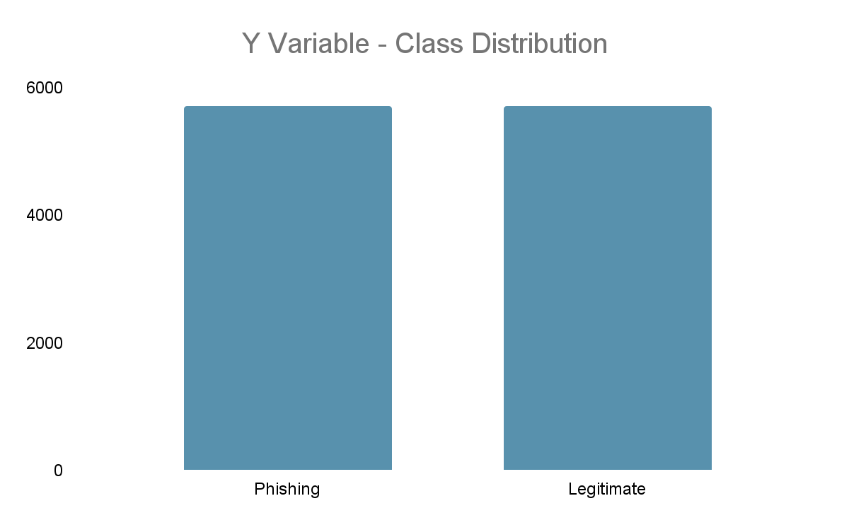
Understanding Data and Features..
87 features were extracted for ~11.4k Websites and analyzed to design prediction models
URL Features
Features quantifying the contents of the URL
The features were built using the URL string available for each website
Eg - URL Length, number of hyphens in URL, etc
Content Features
Qualitative and quantitative features used to describe the content of webpage
Eg - Number of hyperlinks, numbers of images, etc
External Features
Features designed to indicate Webpage relevance with respect to other Webpages in the analysis universe
Eg - Google Search Rank, DNS registration, etc

Slide 7
EDA Key Steps
Correlation and check for Multicollinearity
Categorical to Numerical
& Scaling (Min-Max Scaler)
Feature Engineering
Missing Values
9 Features were finalized to run initial Model iterations

Slide 8
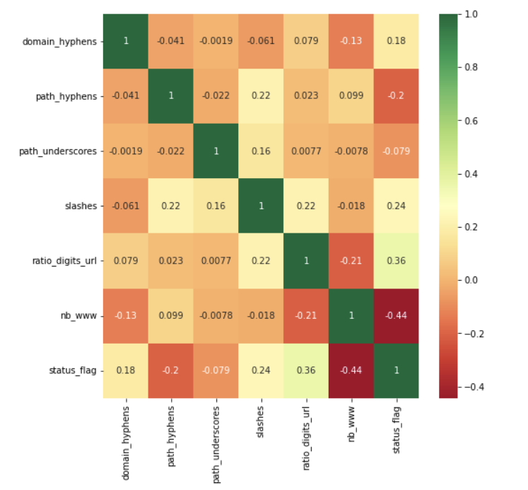
Selecting Features that indicate a strong relationship with Phishing websites
Features based on URL composition
Domain Hyphens - Number of Hyphens in the URL Domain Name
Path Hyphens - Number of Hyphens in the URL Path
Path Underscores - Number of Underscores in the URL Path
Slashes - Number of Slashes in the URL
Ratio Digits to URL - Ratio of Digits to total characters in URL
Number of “WWW”s - Number of “WWW”s used in the URL Name

Slide 9
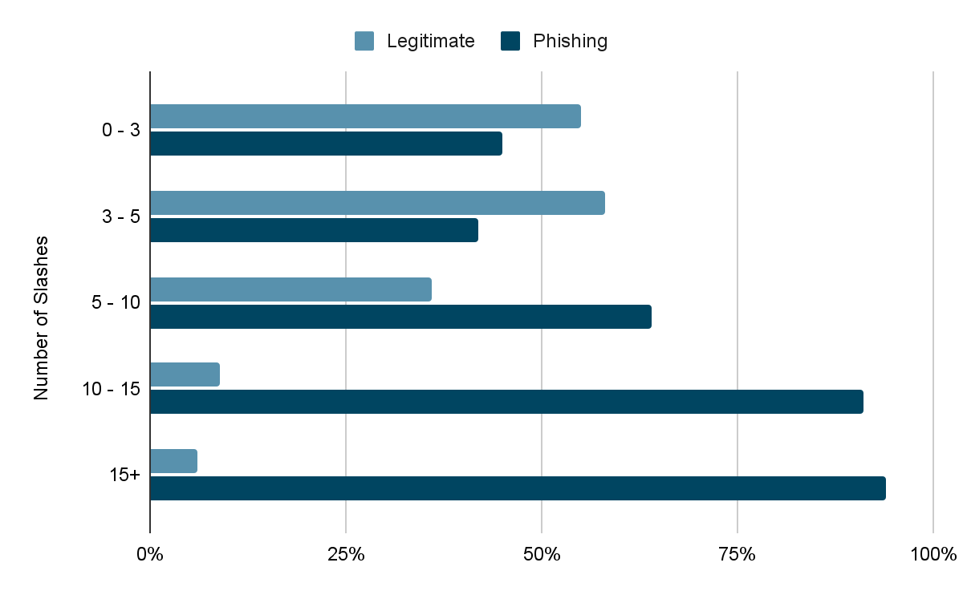
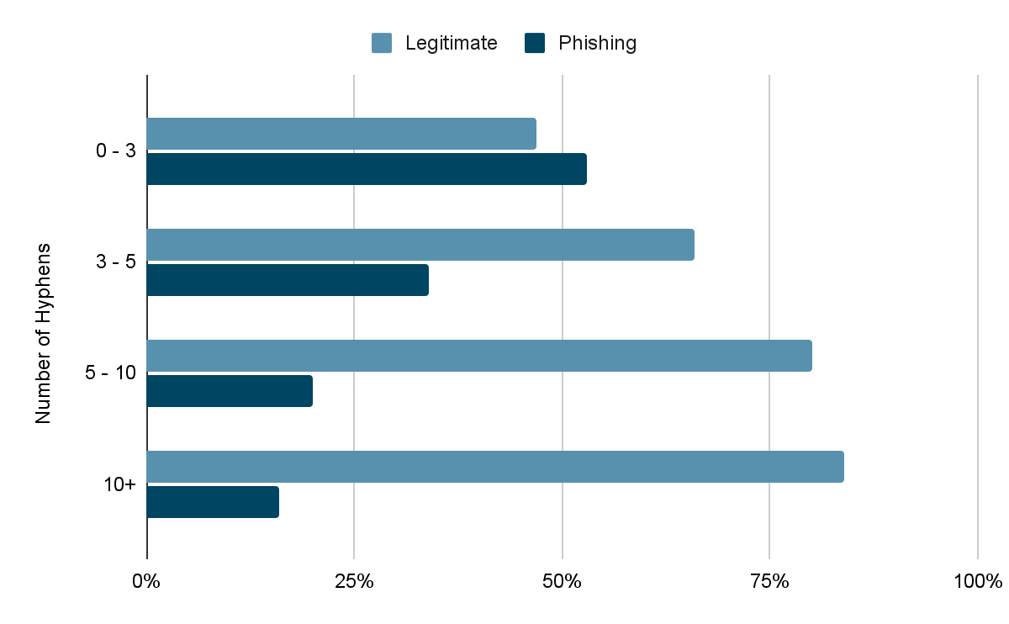
Impact of chosen metrics on Phishing (Y-Variable)
Concentration of Phishing Websites increases in buckets with higher slashes
Concentration of Phishing Websites decreases in buckets with higher Hyphens
Notes:
Voiceover - Accounted for multi-collinearity

Slide 10
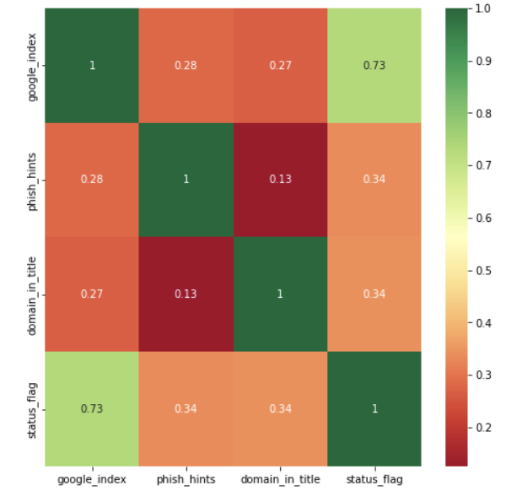
Selecting Features that indicate a strong relationship with Phishing websites
Features with high correlation with Phishing websites
Google Index - Indicates if the URL is indexed by Google
Phishing Hints - Indicates the presence of common Phishing words in the URL Name
Title in Content - Indicates if the title keywords are also present in the content of the webpage

Slide 11
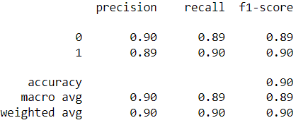
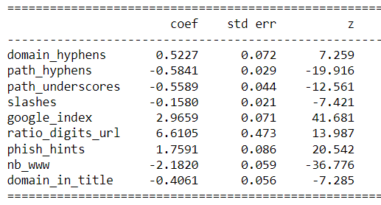
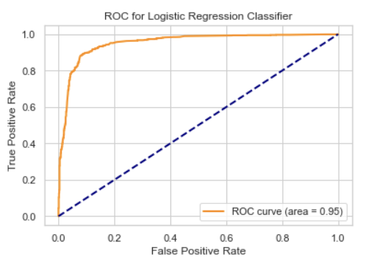
Logistic Regression Classifier (Without RFE)
Multiple Iterations were performed to arrive at the final set of features with |Z-score| > 2
Cross validation results had low standard deviation of recall
Ratio of digits to length of URL is a strong predictor
Notes:
Voiceover - Accounted for multi-collinearity

Slide 12
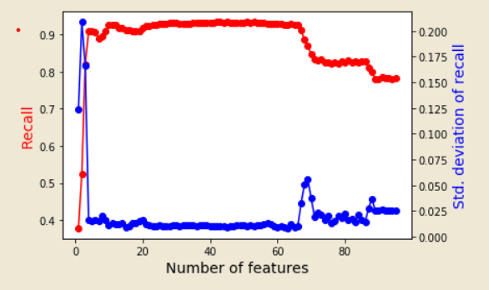
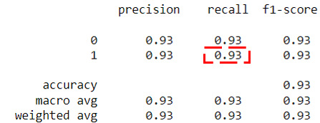
Logistic Regression Classifier (With RFE)
The RFE with cross-validation algorithm recommends 50 features that generate the highest Recall in the Logistic Regression model
However, only marginal incremental recall was obtained after adding 10+ features, leading to an over-complicated model
Features recommended by RFE with cross-validation increased the recall by 3%
Notes:
Voiceover - Accounted for multi-collinearity

Slide 13
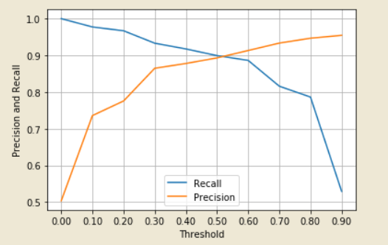
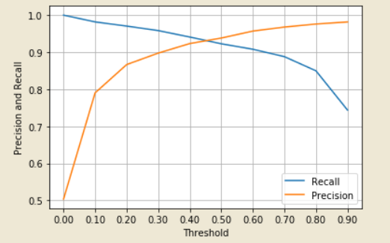
Logistic Regression Threshold Analysis
0.95
0.90
MODEL WITHOUT RFE
MODEL WITH RFE
We can reduce classification threshold to 0.3 to increase recall while maintaining 90% precision
Notes:
Voiceover - Accounted for multi-collinearity

Slide 14
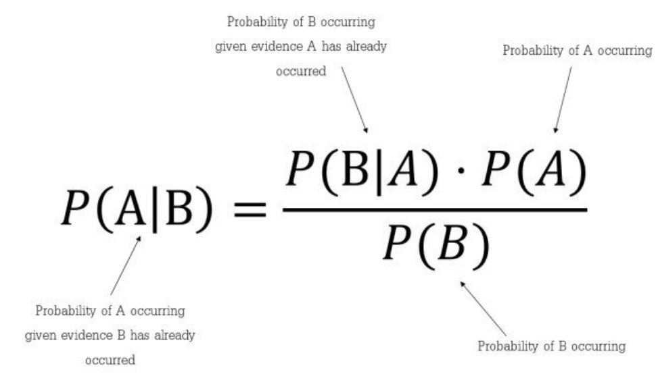
Naive Bayes Model
Baye’s Theorem:
Is it really ‘naive’???
B - predictors or variables
[ X = (x_{1,},x₂…..x_{n}) ]
(length of url, domain hyphens, domain title, etc)
A - Value to be predicted [Y]
(website link is a phishing link or not)
Notes:
Voiceover - Accounted for multi-collinearity

Slide 15

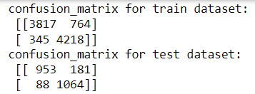
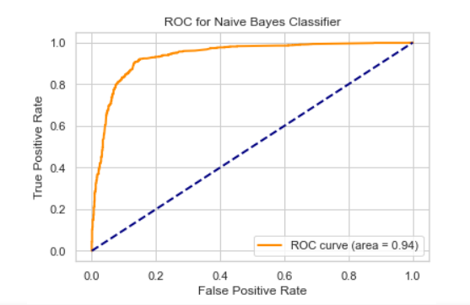
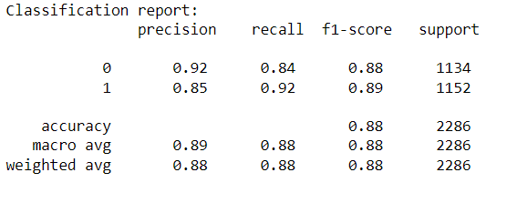
Naive Bayes Model
Model provides a higher recall of 92%
Faster processing
Notes:
Voiceover - Accounted for multi-collinearity

Slide 16
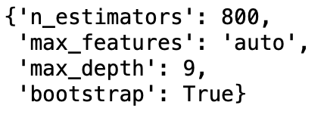
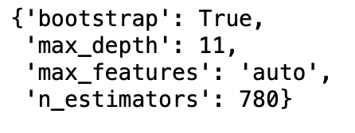
Random Forest Parameter Tuning
Random Search
Grid Search
Notes:
Voiceover - Accounted for multi-collinearity

Slide 17
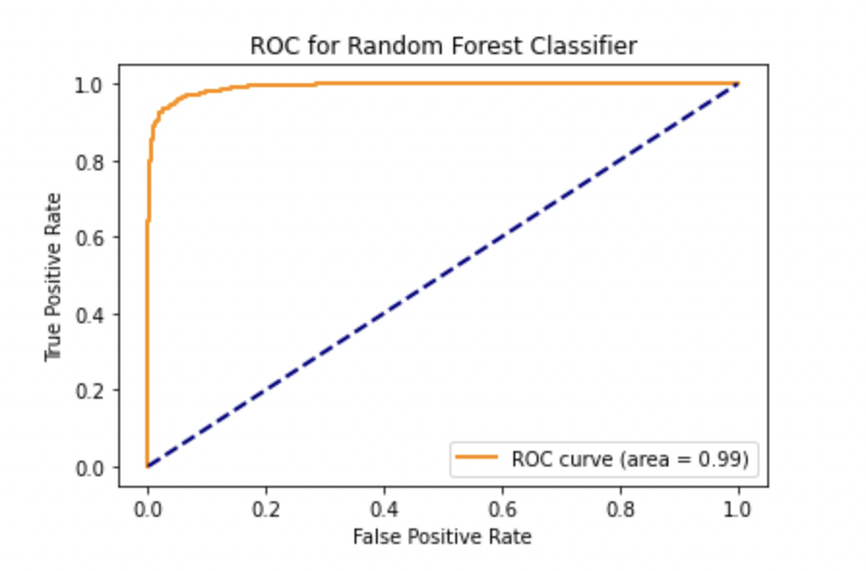
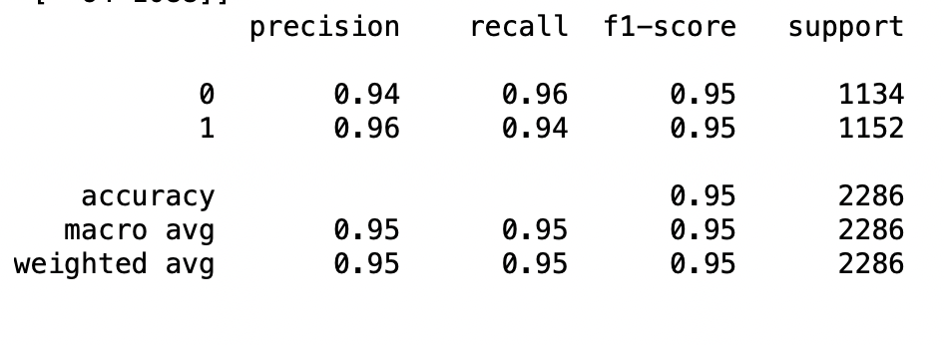
Random Forest Model 1
Using the original 9 features, with the optimal hyperparameters, a recall of 94% was achieved
Notes:
Voiceover - Accounted for multi-collinearity

Slide 18
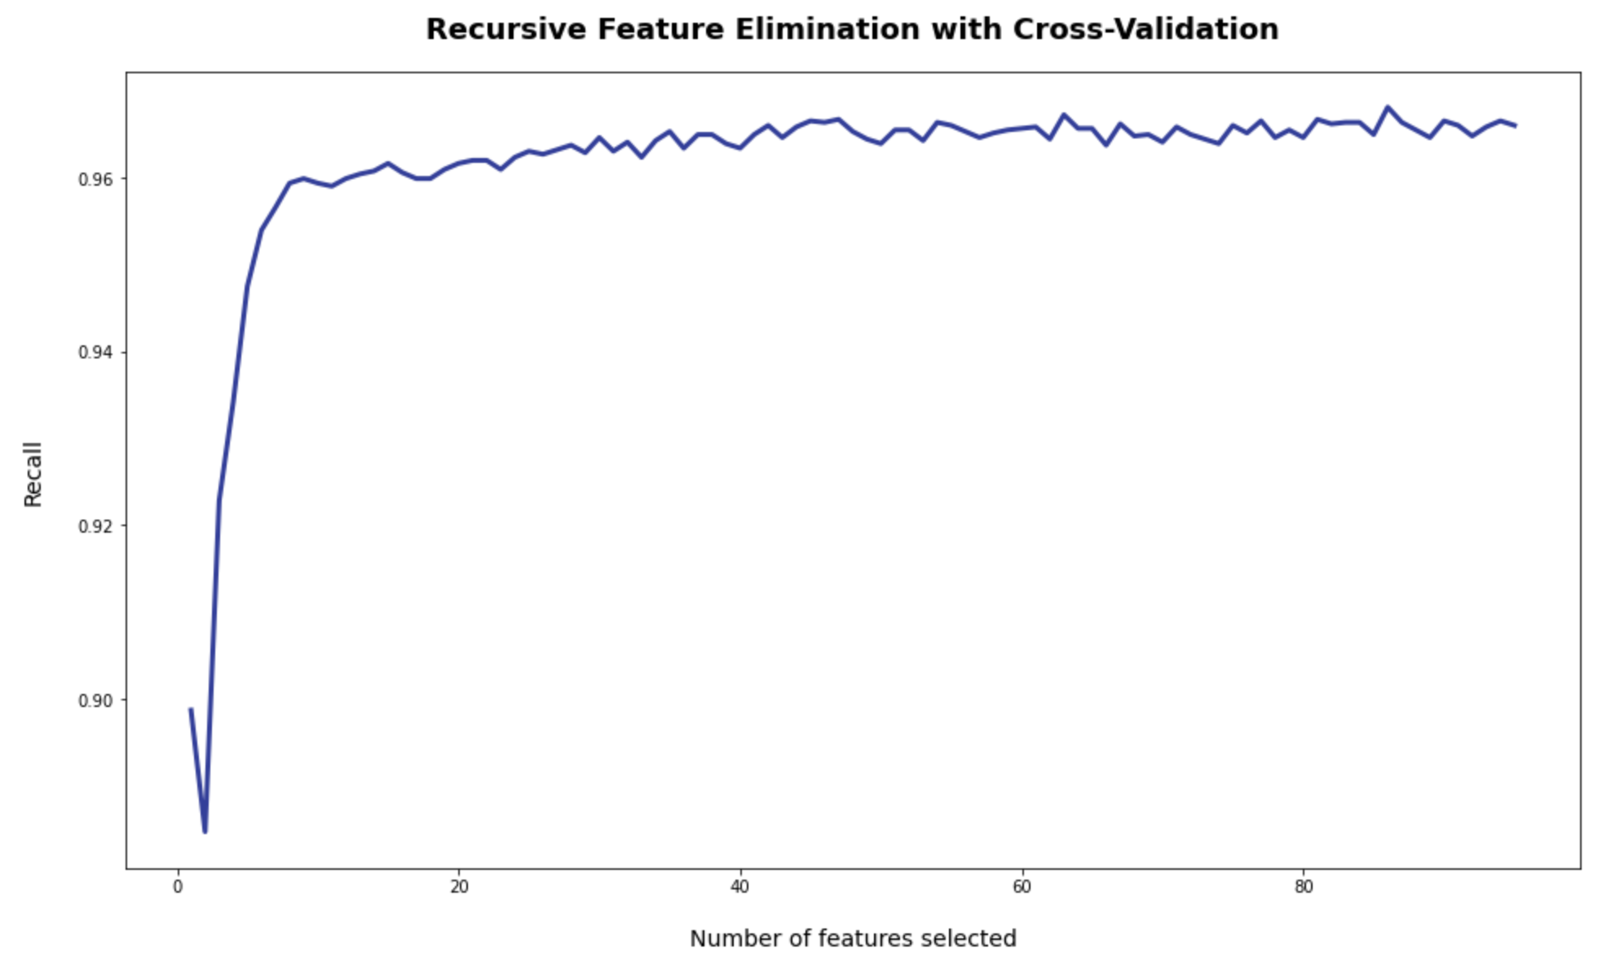
Random Forest Feature Elimination
86 Features were selected by the RFE algorithm
Improvement is marginal after the first 10 features
Notes:
Voiceover - Accounted for multi-collinearity

Slide 19
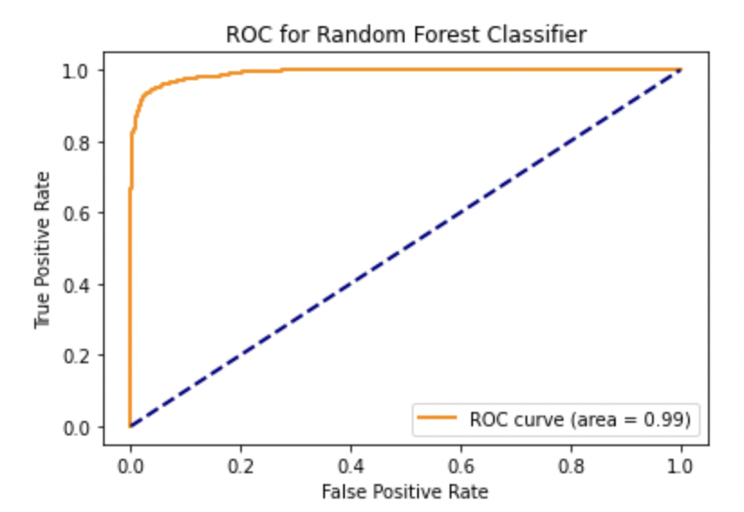
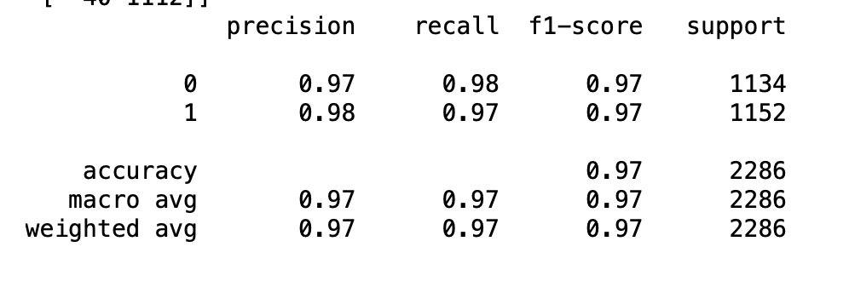
Random Forest Model 2
Another model was ran with all 86 recommended features
A recall of 97% was reached using this technique, which was a welcome improvement over the other methods
Notes:
Voiceover - Accounted for multi-collinearity

Slide 20
Models’ Performance Summary
ML Algorithm | Model | Recall | Precision | F1-score
Naive Bayes | Model 1 - 9 Features | 0.92 | 0.85 | 0.89
Logistic Regression Classifier | Model 1 - 9 Features | 0.90 | 0.89 | 0.90
 | Model 2 - RFE Recommended Features | 0.93 | 0.93 | 0.93
Random Forests | Model 1 - 9 Features | 0.94 | 0.96 | 0.95
 | Model 2 - RFE Recommended Features | 0.97 | 0.98 | 0.97

Slide 21
Conclusion & Next Steps
Improved Random Forest model has best performance with highest precision and recall scores (0.98 and 0.97 respectively)
Limitations: Improved Random Forest recommends large number of features, which may be difficult to obtain data for all and trade-off with model complexity
Next steps:
Determine which features are powerful factors and raise awareness
Inform relevant personnel for update in cyber security protection

Slide 22

Thank you!
Questions?

